Slide 1
Note sample annotations
that follow

Slide 5
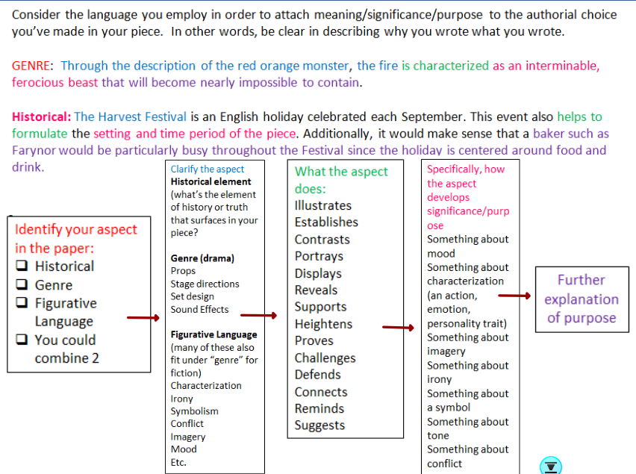

Slide 10
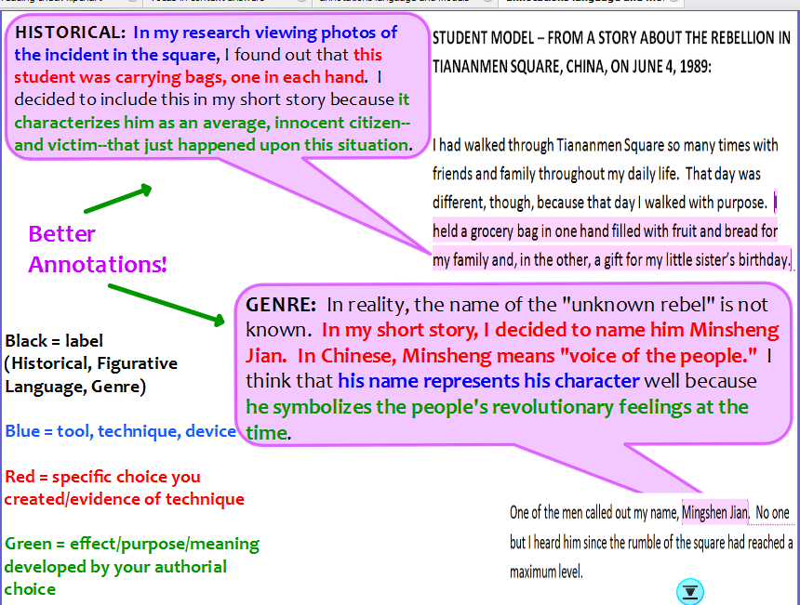

Slide 11
